Slide 1
University management system
Muhammad Abdullah
CMS ID:410849

Slide 2
introduction
· Comprehensive project for academic management
· Utilities include student enrollment and faculty management
· Integration into a user-friendly interface for ease of use
· Scope extends across various academic functionalities
· Facilitates effective communication among students and faculty

Slide 3
languages
·HTML
·CSS
·JavaScript

Slide 4
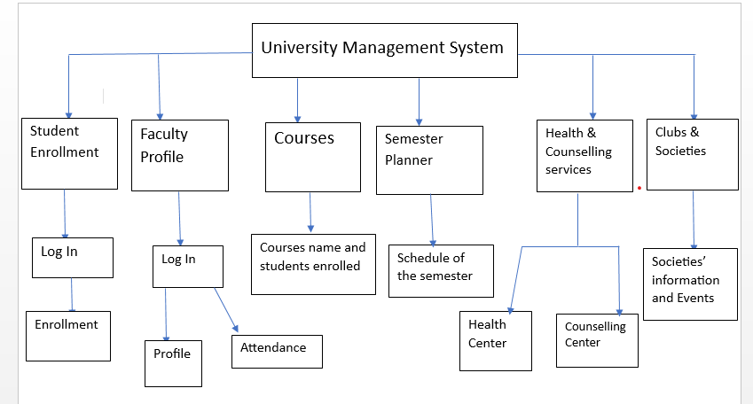
Flowchart:

Slide 5
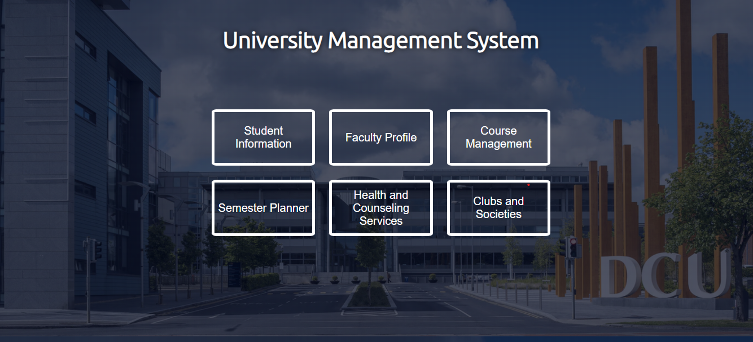
screenshots

Slide 6
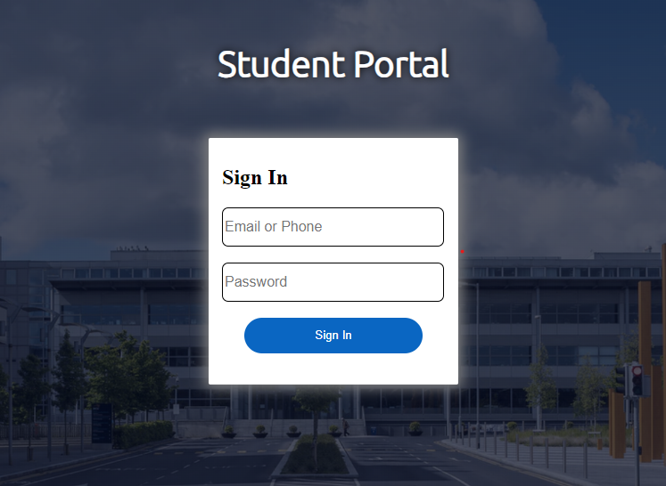
screenshots

Slide 7
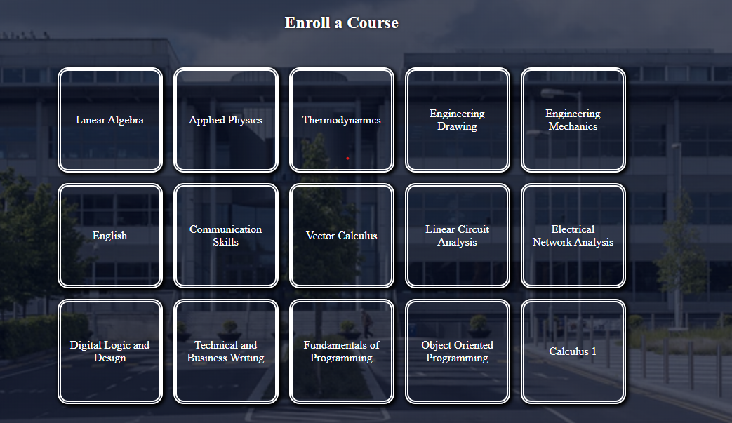
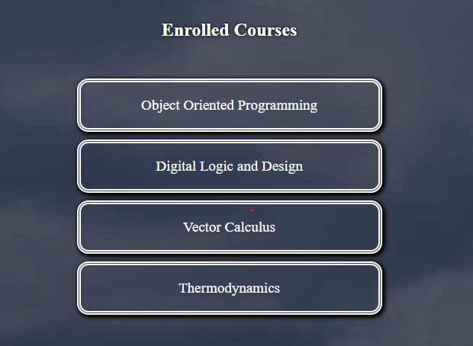
screenshots

Slide 8
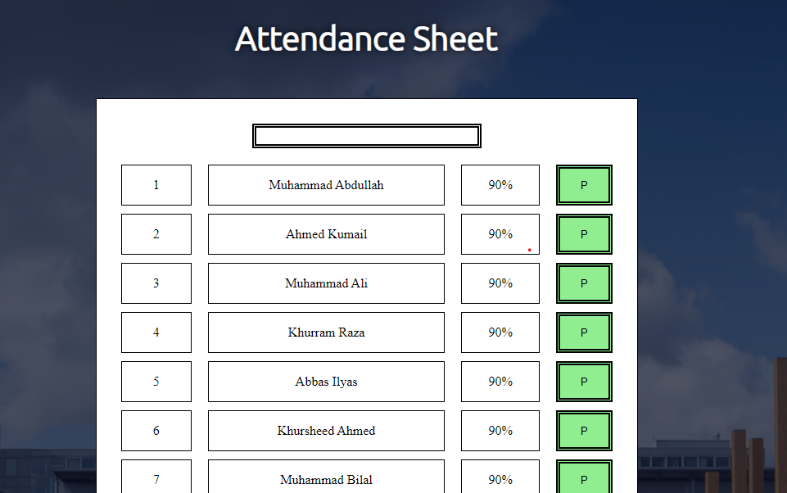
screenshots

Slide 9
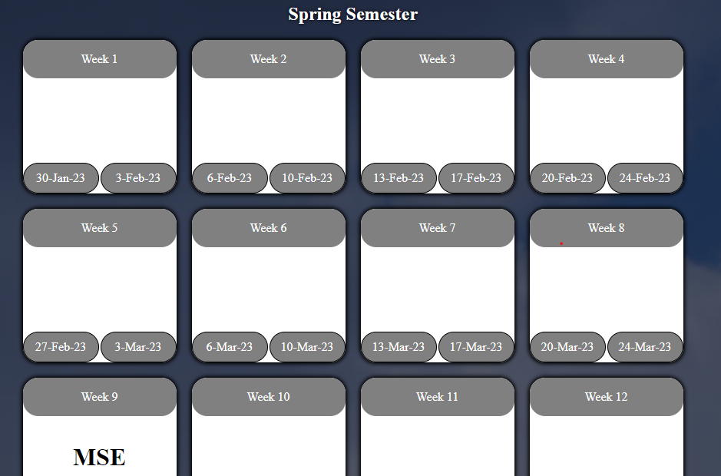
screenshots

Slide 10
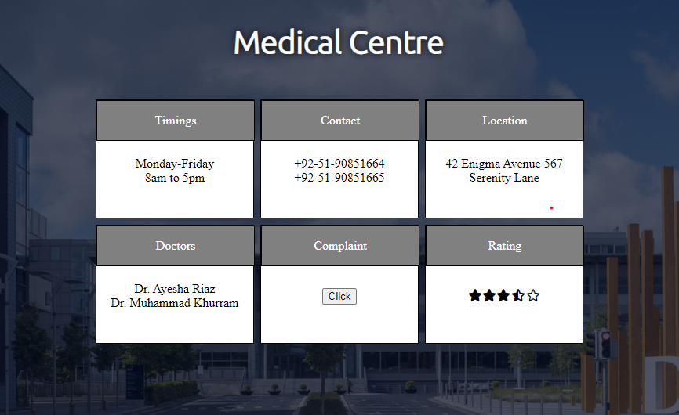
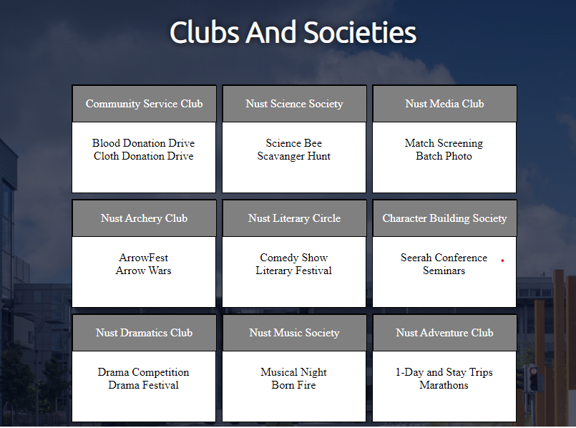
screenshots

Slide 11
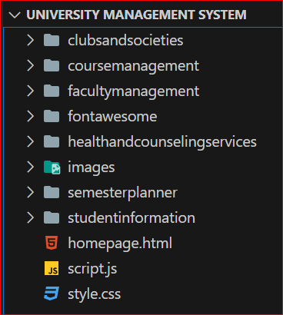
Project folder

Slide 12
Github link
Here is the gihub repository link.
https://github.com/muhammadabdullah12345/University_Management_System

Slide 13
Thank you

